Slide 1


LEO PIZZA sales report
TEAM NAME :
LEO GIRLS
TEAM MEMBERS :
SUTHIKA K
SUBHIKSHAA S
SWETHA V
SRUTI D

Slide 2
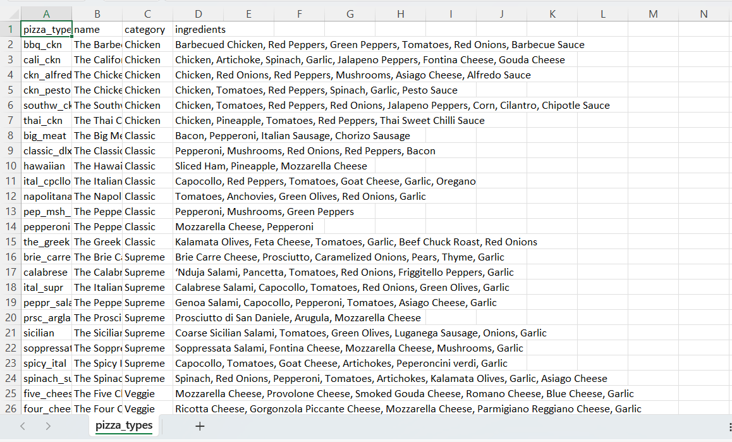
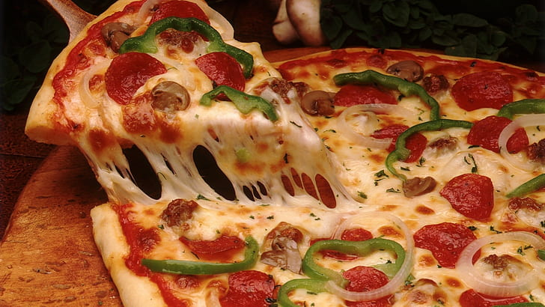
Pizza Place Sales
A year's worth of sales from a fictitious pizza place, including the date and time of each order and the pizzas served, with additional details on the type, size, quantity, price, and ingredients.

Slide 3
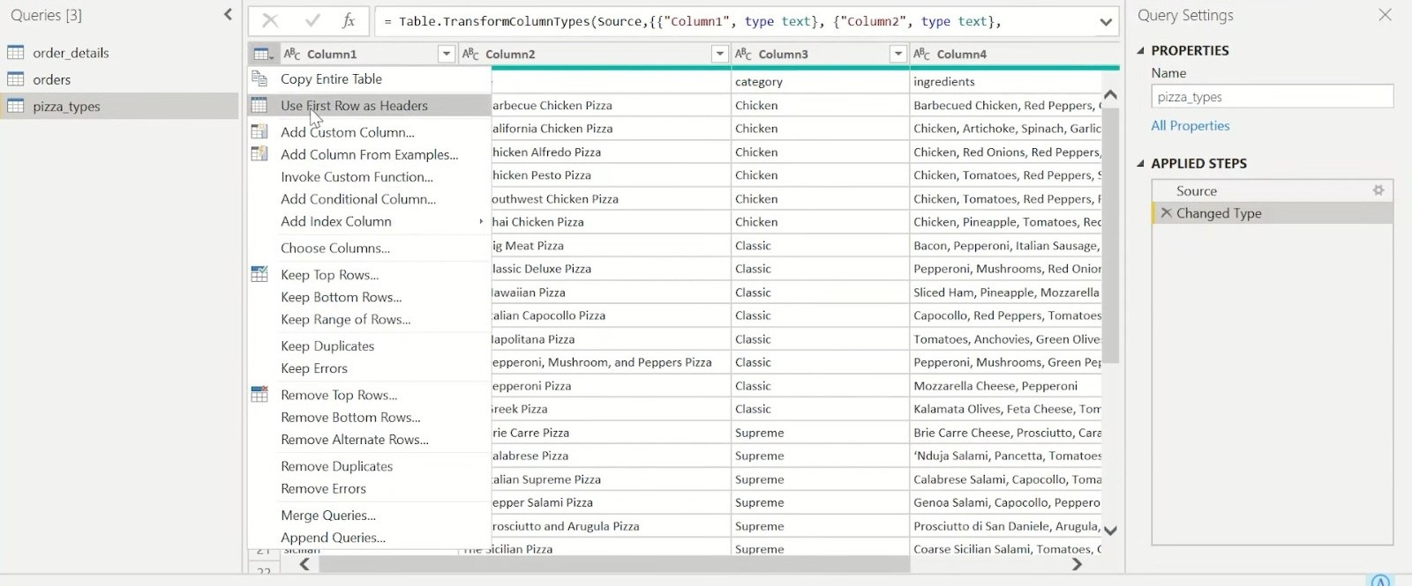
Cleaned data
Cleanse and preprocess data to remove duplicates, missing values, and inconsistencies. This is essential for ensuring data accuracy and reliability.

Slide 4
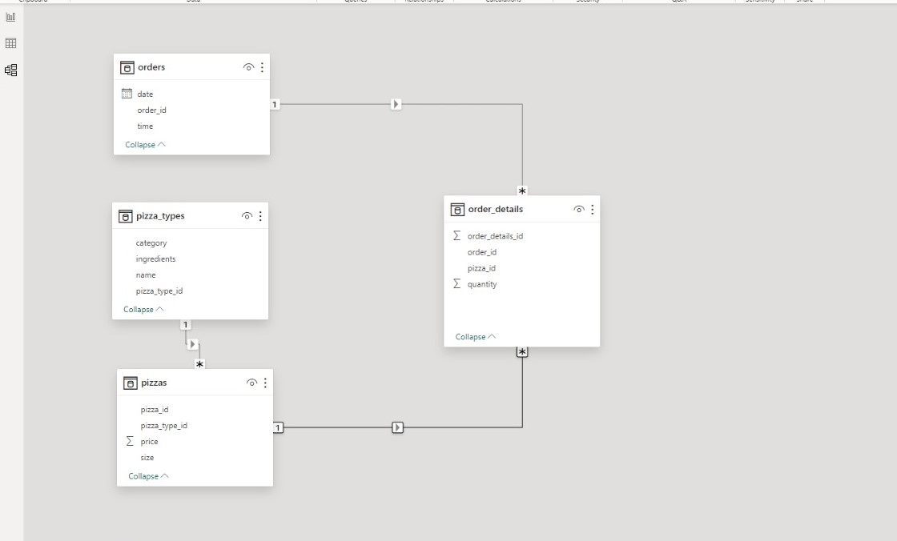
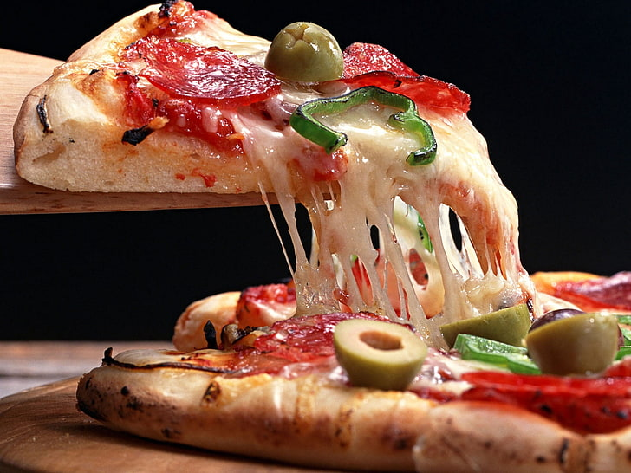
DATA MODELLING
Data modeling is a critical component of data analytics for Leo pizza and is essential for understanding and optimizing various aspects of the business.

Slide 5
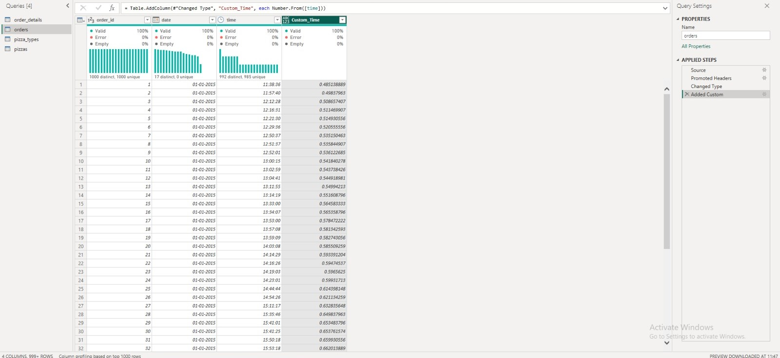
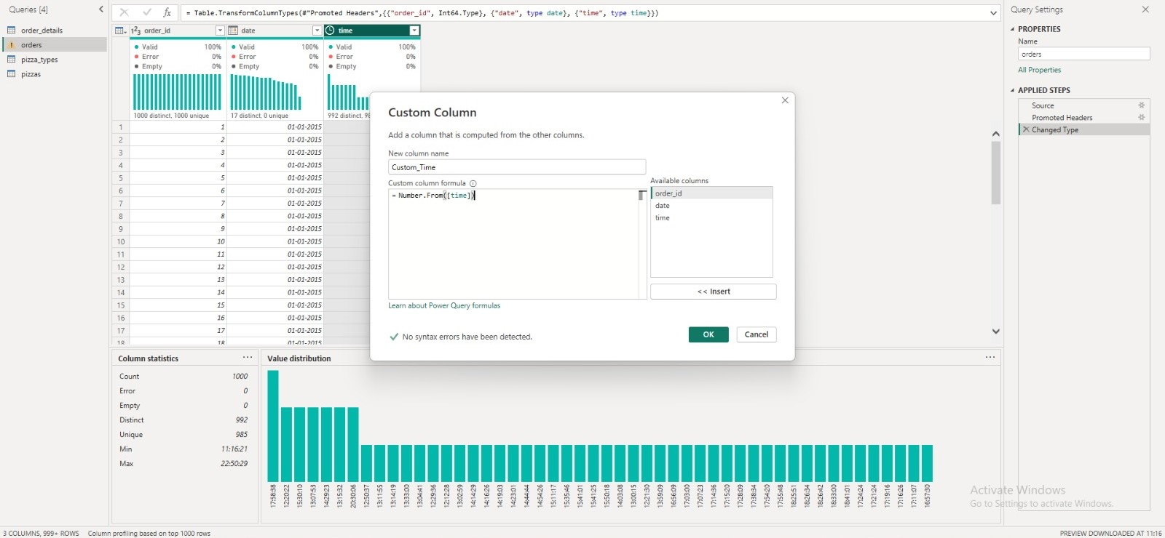
Column,measure of report

Slide 6
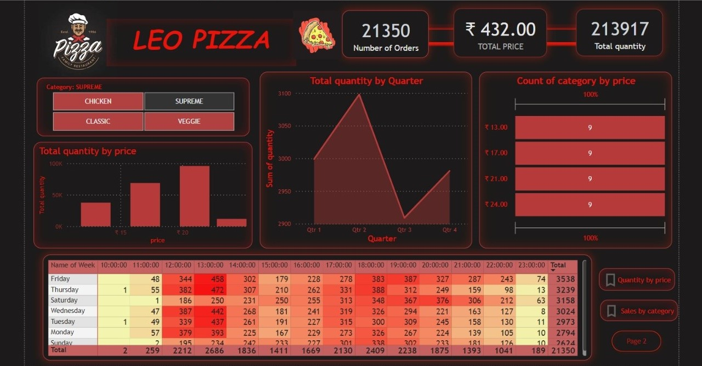
REPORT page 1

Slide 7
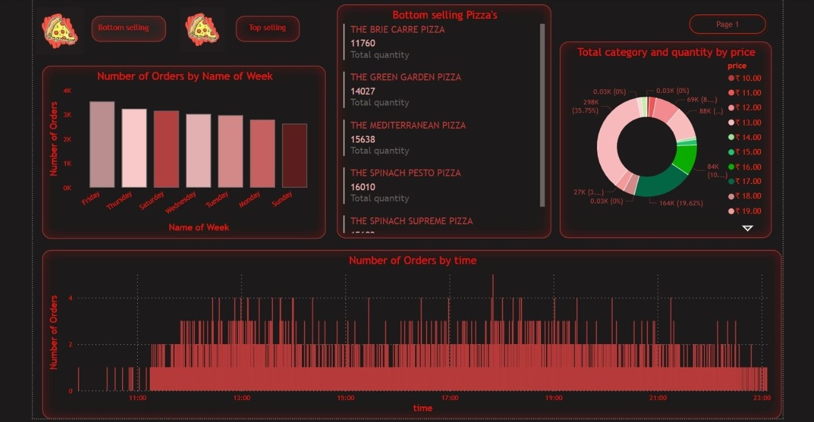
PAGE 2

Slide 8
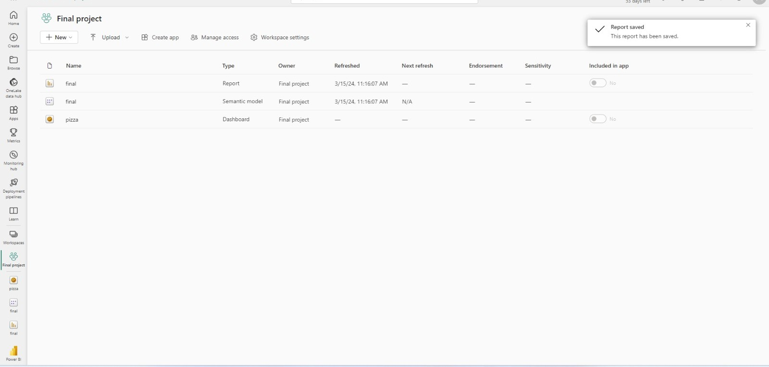
WORKSPACE

Slide 9
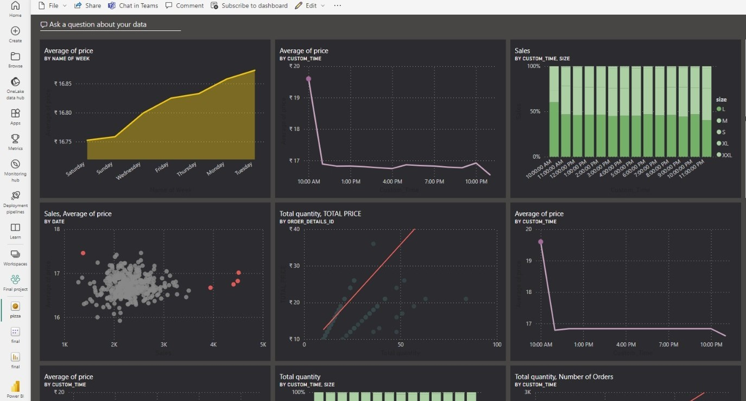
DASHBOARD

Slide 10

CONCLUSION
In conclusion, conducting data analytics for Leo pizza involves collecting, processing, and analyzing data to gain insights and make informed decisions related to the restaurant chain's operations, marketing, and customer experiences.

Slide 11
Here's to many more slices together!

